Slide 1
Energy Consumption Monitoring and Optimization for Home Appliances via Cloud
Submitted in the partial fulfillment for the award of the degree of
BACHELOR OF ENGINEERING
IN
INTERNET OF THINGS & CLOUD COMPUTING
Submitted by:
22BIT70018 Pathivada Yathin Kumar
22BCC70130 Sathwik Nadipalli
22BIT70007 Durga Prasad
22BIT70062 Rishabh Kumar
Under the Supervision of:
Tejinder Pal Singh (E16552)
Department of AIT-CSE
DISCOVER . LEARN . EMPOWER

Slide 2
Outline
Evaluation & Selection of Specifications/Features
Design Constraints
Analysis of Features and Finalization Subject to Constraints
Design Flow
Design Selection
Implementation Plan / Methodology

Slide 3
Evaluation & Selection of Specifications / Features
The system requires smart sensing devices to measure voltage, current, power, and cumulative energy use for individual appliances.
A cloud-connected design is selected so collected readings can be stored remotely, visualized, and analyzed over time.
Core features chosen are real-time monitoring, historical usage tracking, abnormal consumption detection, and remote appliance control.
IoT communication support is necessary to transfer data reliably between sensing nodes, gateway devices, and the cloud.
The final specification emphasizes low cost, scalability, user convenience, and easy integration with household appliances.

Slide 4
Design Constraints
The overall solution must remain affordable because home energy monitoring systems should be practical for residential users.
Internet dependency affects cloud connectivity, so the design should handle temporary network interruption and delayed synchronization.
Sensor accuracy and electrical safety are major constraints because the system interfaces directly with household appliances.
Continuous monitoring generates large amounts of data, which creates storage, bandwidth, and cloud processing challenges.
The monitoring hardware itself should consume very little power and should not add significant energy overhead.

Slide 5
Analysis of Features and Finalization Subject to Constraints
Real-time monitoring was prioritized because it helps users identify waste immediately and observe live appliance behavior.
Historical analytics was retained because cloud platforms support trend analysis, comparison of daily usage, and optimization planning.
Remote ON/OFF control and scheduling were included because they improve convenience and enable better load management.
Advanced functions were selected only if they provided useful benefits without making the system too expensive or complex.
The finalized system includes sensing, communication, cloud storage, analytics, dashboard access, and optimization/control modules.

Slide 6
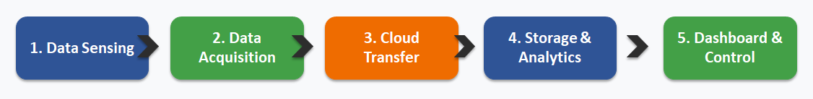
Design Flow
Appliance sensors measure power usage and send readings to a controller or gateway.
The gateway forwards the data to the cloud for storage, processing, and analysis.
Users access real-time and historical information through a web or mobile dashboard.
The optimization layer generates alerts, recommendations, or control actions to reduce waste.

Slide 7
Design Selection
A cloud-based IoT architecture is selected instead of a purely local system because it offers better remote access and scalability.
Appliance-level monitoring is preferred over whole-home total monitoring because it clearly identifies which devices consume the most energy.
The chosen design combines sensors, microcontroller or gateway, cloud database, analytics engine, and user dashboard.
This design supports both monitoring and optimization, which makes it more useful than systems that only display data.
The selected model provides a good balance between functionality, implementation effort, future expansion, and cost.

Slide 8
Implementation Plan / Methodology
Phase 1: Select hardware components such as energy sensors, smart plugs, and microcontroller or gateway devices.
Phase 2: Configure data collection and establish communication between appliances, sensors, and the cloud platform.
Phase 3: Develop the cloud backend for storing readings, processing data, and generating analytical insights.
Phase 4: Build a user dashboard for real-time monitoring, alerts, historical graphs, and remote control.
Phase 5: Test the complete system for accuracy, reliability, communication performance, and energy-saving effectiveness.

Slide 9
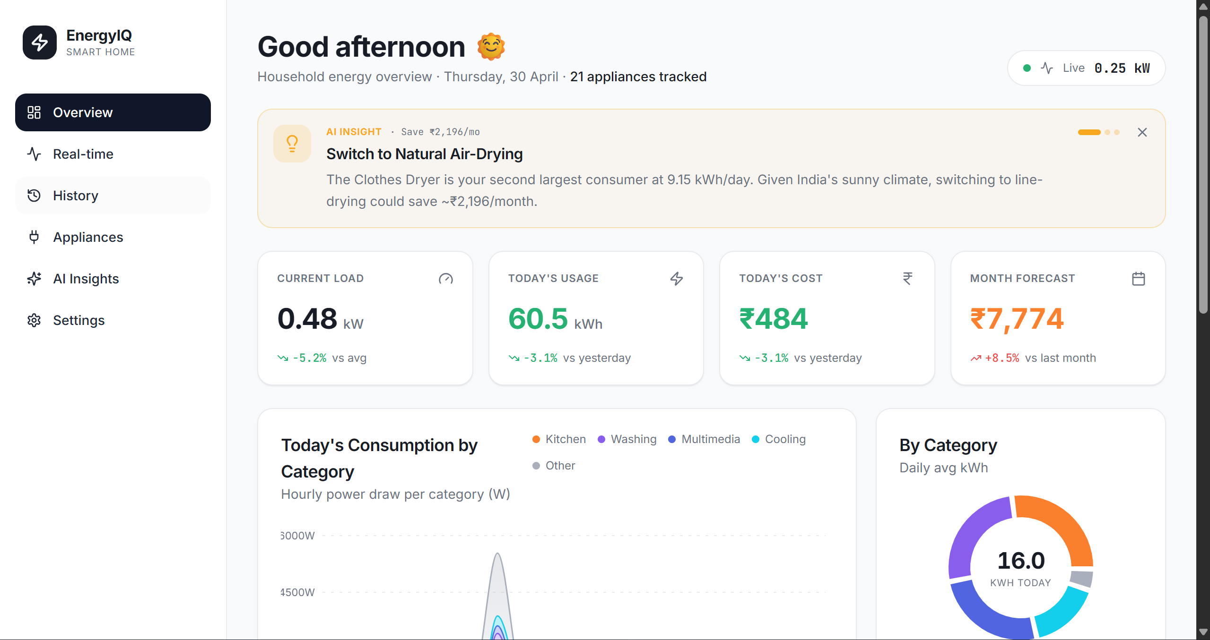

Slide 10
Outcome of Design Process
The final design produces a practical and scalable cloud-based smart home energy monitoring framework.
It supports real-time tracking, appliance-level analysis, remote monitoring, and optimization of electricity usage.
The system can reduce unnecessary power consumption, lower electricity bills, and promote sustainable energy behavior.

Slide 11
THANK YOU

